Slide 1
Instruction Sets: Characteristics & Functions
Notes:
Much of what is discussed in this book is not readily apparent to the user or programmer of a computer. If a programmer is using a high-level language, such as Pascal or Ada, very little of the architecture of the underlying machine is visible.
One boundary where the computer designer and the computer programmer can view the same machine is the machine instruction set. From the designer’s point of view, the machine instruction set provides the functional requirements for the processor: implementing the processor is a task that in large part involves implementing the machine instruction set. The user who chooses to program in machine language (actually, in assembly language; see Appendix B) becomes aware of the register and memory structure, the types of data directly supported by the machine, and the functioning of the ALU.
A description of a computer’s machine instruction set goes a long way toward explaining the computer’s processor. Accordingly, we focus on machine instructions in this chapter and the next.

Slide 2
Machine Instruction Characteristics
The operation of the processor is determined by the instructions it executes, referred to as machine instructions or computer instructions.
The collection of different instructions that the processor can execute is referred to as the processor’s instruction set.
Each instruction must contain the information required by the processor for execution.
Notes:
2
The operation of the processor is determined by the instructions it executes, referred to as machine instructions or computer instructions. The collection of different instructions that the processor can execute is referred to as the processor’s instruction set.
Each instruction must contain the information required by the processor for execution.

Slide 3
Elements of Machine Instruction
Operation Code (opcode)
Source operand reference
Result operand reference
Next instruction reference
Source and result operands can be in one of four areas:
Main memory
I/O Device
Processor register
Immediate

Slide 4
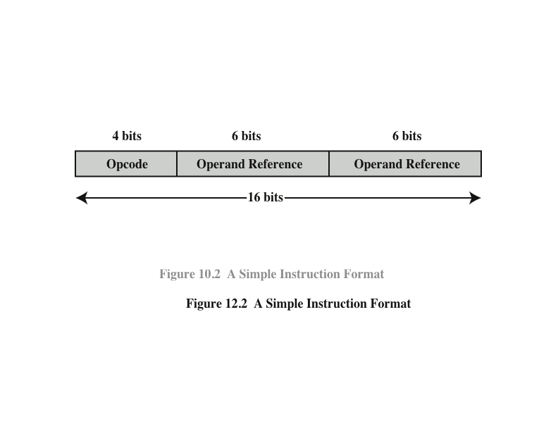
Instruction Representation
Within the computer each instruction is represented by a sequence of bits
The instruction is divided into fields, corresponding to the constituent elements of the instruction
Notes:
5
Within the computer, each instruction is represented by a sequence of bits. The instruction is divided into fields, corresponding to the constituent elements of the instruction.
A simple example of an instruction format is shown in Figure 12.2. As another example, the IAS instruction format is shown in Figure 2.2. With most instruction sets, more than one format is used. During instruction execution, an instruction is read into an instruction register (IR) in the processor. The processor must be able to extract the data from the various instruction fields to perform the required operation.
It is difficult for both the programmer and the reader of textbooks to deal with binary representations of machine instructions. Thus, it has become common practice to use a symbolic representation of machine instructions. An example of this was used for the IAS instruction set, in Table 2.1.

Slide 5
Opcodes are represented by abbreviations, called mnemonics, that indicate the operation.
ADD Add
SUB Subtract
MUL Multiply
DIV Divide
LOAD Load data from memory
STOR Store data to memory
Operands are also represented symbolically.
ADD R, Y

Slide 6

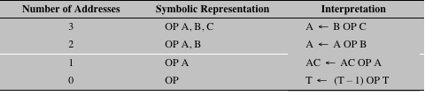
Number of Addresses
Notes:
8
Table 12.1 summarizes the interpretations to be placed on instructions with zero, one, two, or three addresses. In each case in the table, it is assumed that the address of the next instruction is implicit, and that one operation with two source operands and one result operand is to be performed.
The number of addresses per instruction is a basic design decision. Fewer addresses per instruction result in instructions that are more primitive, requiring a less complex processor. It also results in instructions of shorter length. On the other hand, programs contain more total instructions, which in general results in longer execution times and longer, more complex programs. Also, there is an important threshold between one-address and multiple-address instructions. With one-address instructions, the programmer generally has available only one general-purpose register, the accumulator. With multiple-address instructions, it is common to have multiple general-purpose registers. This allows some operations to be performed
solely on registers. Because register references are faster than memory references, this speeds up execution. For reasons of flexibility and ability to use multiple registers, most contemporary machines employ a mixture of two- and three-address instructions.
The design trade-offs involved in choosing the number of addresses per instruction are complicated by other factors. There is the issue of whether an address references a memory location or a register. Because there are fewer registers, fewer bits are needed for a register reference. Also, as we shall see in Chapter 13, a machine may offer a variety of addressing modes, and the specification of mode takes one or more bits. The result is that most processor designs involve a variety of instruction formats.

Slide 7
Compare zero-, one-, two-, and three-address machines by writing instructions to compute:
X=(A+B)*(C+D)
X=(A*B)+(C*D)+E
for each of the four machines. The instructions available for use are as follows:

Slide 8
Instruction Types
Data Processing
Arithmetic instructions provide computational capabilities for processing numeric data
Logic (Boolean) instructions operate on the bits of a word as bits rather than as numbers, thus they provide capabilities for processing any other type of data the user may wish to employ
Data Storage
Movement of data into or out of register and or memory locations
Data Movement
I/O instructions are needed to transfer programs and data into memory and the results of computations back out to the user
Control
Test instructions are used to test the value of a data word or the status of a computation
Branch instructions are used to branch to a different set of instructions depending on the decision made

Slide 9
Types of Operands
Addresses
Numbers
All machine languages include numeric data types
Numbers stored in a computer are limited (representable on a machine)
Numerical data computers: Binary or Decimal
Packed decimal
Each decimal digit is represented by a 4-bit code with two digits stored per byte
Standard sign values are 1100 for positive (+) and 1101 for negative (-)
Characters
Most commonly used character code is the International Reference Alphabet (IRA) or American Standard Code for Information Interchange (ASCII)
Logical Data
An n-bit unit consisting of n 1-bit items of data, each item having the value 0 or 1

Slide 10
Types of Operations
Data Transfer
Transfer data from one location to another
Arithmetic
Perform functions in ALU, set condition flags
May involve data transfer
Logical
Conversion
May involve special logic to perform conversion
I/O
Issue command to I/O module
Transfer of Control

Slide 11
Transfer of Control
Reasons why transfer-of-control operations are required:
It is essential to be able to execute each instruction more than once
Virtually all programs involve some decision making
It helps if there are mechanisms for breaking the task up into smaller pieces that can be worked on one at a time
Most common transfer-of-control operations found in instruction sets:
Branch
Skip
Procedure call
Notes:
25
For all of the operation types discussed so far, the next instruction to be performed is the one that immediately follows, in memory, the current instruction. However, a significant fraction of the instructions in any program have as their function changing the sequence of instruction execution. For these instructions, the operation per- formed by the processor is to update the program counter to contain the address of some instruction in memory.
There are a number of reasons why transfer-of-control operations are required. Among the most important are the following:
In the practical use of computers, it is essential to be able to execute each instruction more than once and perhaps many thousands of times. It may require thousands or perhaps millions of instructions to implement an application. This would be unthinkable if each instruction had to be written out separately. If a table or a list of items is to be processed, a program loop is needed. One sequence of instructions is executed repeatedly to process all the data.
Virtually all programs involve some decision making. We would like the computer to do one thing if one condition holds, and another thing if another condition holds. For example, a sequence of instructions computes the square root of a number. At the start of the sequence, the sign of the number is tested. If the number is negative, the computation is not performed, but an error condition is reported.
To compose correctly a large or even medium-size computer program is an exceedingly difficult task. It helps if there are mechanisms for breaking the task up into smaller pieces that can be worked on one at a time.

Slide 12
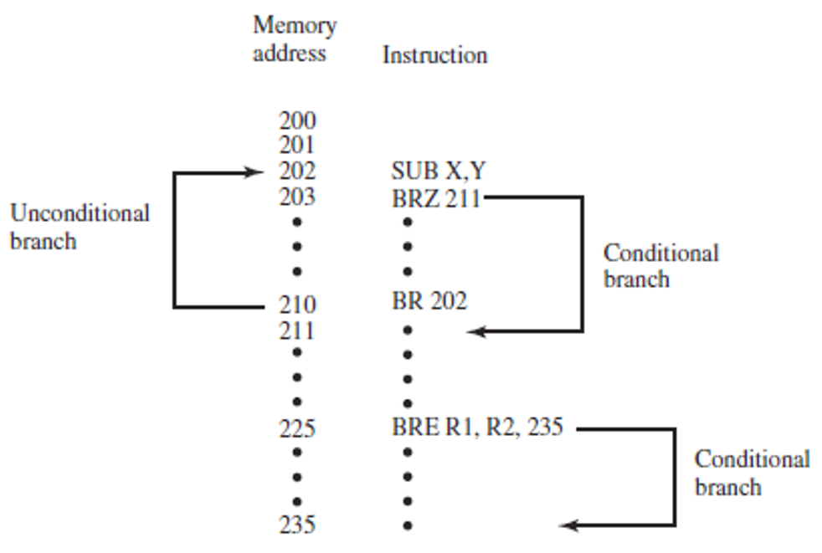
Branch Instructions
A branch instruction, also called a jump instruction, has as one of its operands the address of the next instruction to be executed.
Examples:
BRE R1, R2, X Branch to X if contents of R1 = contents of R2
BRN X Branch to location X if result is negative
BRZ X Branch to location X if result is zero

Slide 13
Skip Instructions
Includes an implied address
Typically implies that one instruction be skipped, thus the implied address equals the address of the next instruction plus one instruction length

Slide 14
Procedure Call Instructions
Self-contained computer program that is incorporated into a larger program
At any point in the program the procedure may be invoked, or called
Processor is instructed to go and execute the entire procedure and then return to the point from which the call took place
Two principal reasons for use of procedures:
Economy
A procedure allows the same piece of code to be used many times
Modularity
Involves two basic instructions:
A call instruction that branches from the present location to the procedure
Return instruction that returns from the procedure to the place from which it was called
Notes:
Perhaps the most important innovation in the development of programming languages is the procedure. A procedure is a self- contained computer program that is incorporated into a larger program. At any point in the program the procedure may be invoked, or called. The processor is instructed to go and execute the entire procedure and then return to the point from which the call took place.
The two principal reasons for the use of procedures are economy and modularity. A procedure allows the same piece of code to be used many times. This is important for economy in programming effort and for making the most efficient use of storage space in the system (the program must be stored). Procedures also allow large programming tasks to be subdivided into smaller units. This use of modularity greatly eases the programming task.
The procedure mechanism involves two basic instructions: a call instruction that branches from the present location to the procedure, and a return instruction that returns from the procedure to the place from which it was called. Both of these are forms of branching instructions.

Slide 15
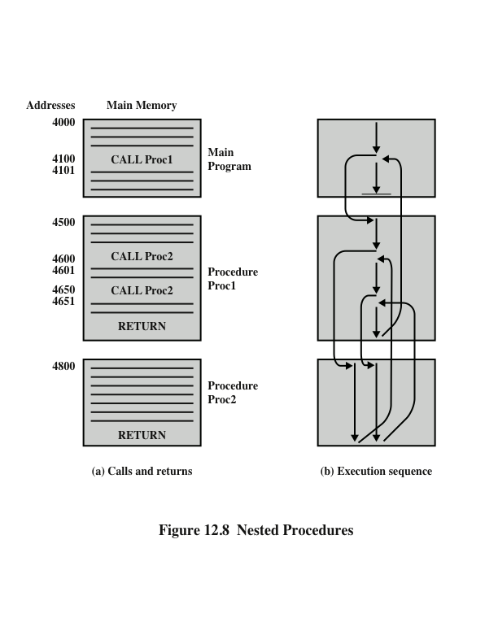
Nested Procedures
Notes:
Figure 12.8a illustrates the use of procedures to construct a program. In this example, there is a main program starting at location 4000. This program includes a call to procedure PROC1, starting at location 4500. When this call instruction is encountered, the processor suspends execution of the main program and begins execution of PROC1 by fetching the next instruction from location 4500. Within PROC1, there are two calls to PROC2 at location 4800. In each case, the execution of PROC1 is suspended and PROC2 is executed. The RETURN statement causes the processor to go back to the calling program and continue execution at the instruction after the corresponding CALL instruction. This behavior is illustrated in Figure 12.8b.

Slide 16
There are three common places for storing the return address:
Consider a machine-language instruction CALL X, which stands for call procedure at location X.
Register: RN<- PC + ∆ ; PC<- X
Start of called procedure: X<-PC + ∆ ; PC<-X+1
The only limitation of these approaches is that they complicate the use of reentrant procedures.
A reentrant procedure is one in which it is possible to have several calls open to it at the same time.

Slide 17
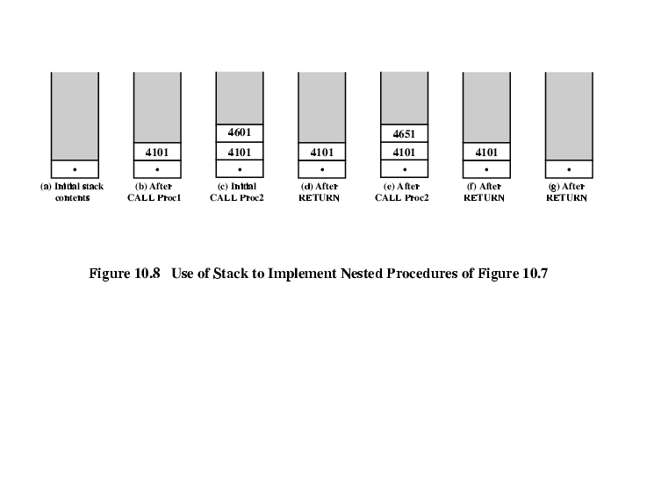
Top of Stack: Saving the return address for re-entrant procedures

Slide 18
Instruction Set Design
Operation repository: How many and which operations to provide, and how complex operations should be
Data types: The various types of data upon which operations are performed
Instruction format: Instruction length (in bits), number of addresses, size of various fields, and so on
Registers: Number of processor registers that can be referenced by instructions, and their use
Addressing: The mode or modes by which the address of an operand is specified

Slide 19
Consider a hypothetical computer with an instruction set of only two n-bit instructions. The first bit specifies the opcode, and the remaining bits specify one of the 2^(n-1) n-bit words of main memory. The two instructions are as follows:
SUBS X: Subtract the contents of location X from the accumulator, and store the result in location X and the accumulator.
JUMP X: Place address X in the program counter.
A word in main memory may contain either an instruction or a binary number in twos complement notation. Demonstrate that this instruction set is reasonably complete by specifying how the following operations can be programmed:
Data transfer: Location X to accumulator, accumulator to location X
Addition: Add contents of location X to accumulator

Slide 20
Reference
Computer Organization and Architecture: Designing for Performance, William Stallings, 9th Edition, Pearson India, 2013.

